Slide 1
BLIND SQL INjection

Slide 2
Title:- Blind SQL Injecton
Domain:-Vulnweb.com
Subdomain:- testasp.vulnwev.com
Steps to reproduce:-
Step 1:- Vist http://testasp.vulnweb.com.
Step 2:- On the top menu you will find a login option.
Step 3:- Click on it and you will be prompted with the login page.
Step 4:- The credintials i used on this login page was USERNAME:-tfUName PASSWORD:--1' OR 3*2*1=6 AND 000724=000724 --
Step 5:- You can easyily get admin access on the website.

Slide 3
The Impact of this vulnerability:-An attacker may execute arbitrary SQL statements on the vulnerable system.
This may compromise the integrity of your database and/or expose sensitive information.Depending on the back-end database in use,
SQL injection vulnerabilities lead to varying levels of data/system access for the attacker. It may be possible to not only manipulate
existing queries,but to UNION in arbitrary data, use sub selects, or append additional queries.
In some cases, it may be possible to read in or write out to files, or to execute shell commands on the underlying operating system.

Slide 4
How to fix this vulnerability:-Your script should filter metacharacters from user input.
Sanitize the input
It's absolutely vital to sanitize user inputs to insure that they do not contain dangerous codes, whether to the SQL server or to HTML itself.
One's first idea is to strip out "bad stuff", such as quotes or semicolons or escapes, but this is a misguided attempt.
Though it's easy to point out some dangerous characters, it's harder to point to all of them

Slide 5
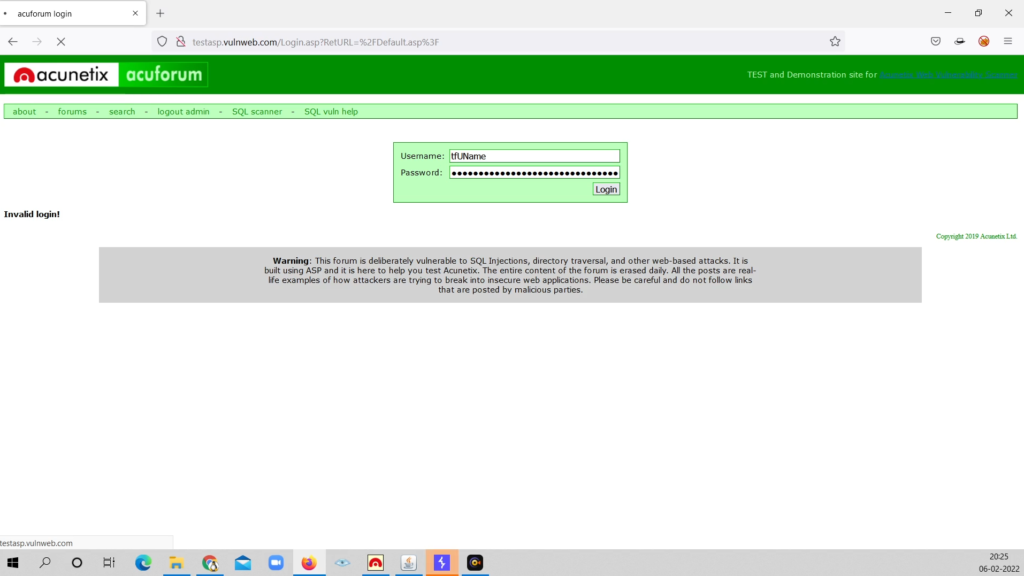
POC including screenshot/screen recording is included in the report which is attached below.

Slide 6
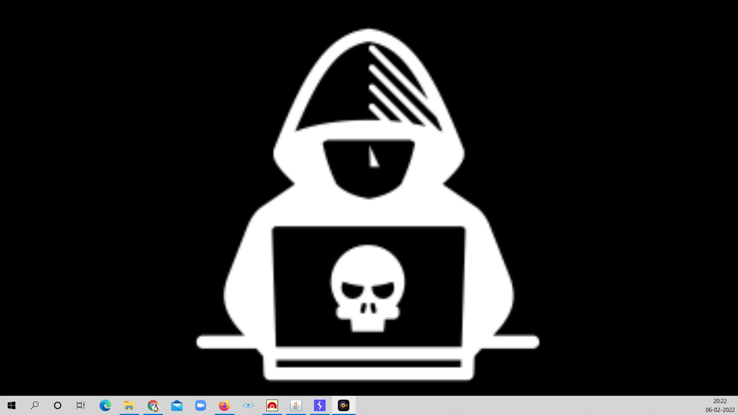
Screen recording

